Slide 1
Child Car Seat Footrest
Existing Solutions from Cursory Internet Search

Slide 2
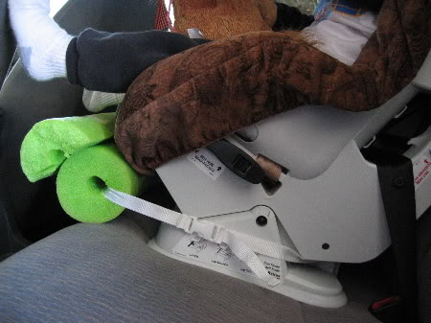
Desperate-Parent Jury-Rig

Slide 3
Hanging Cylinder

Slide 4
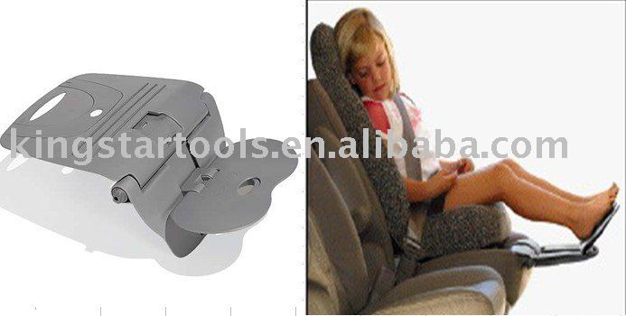
Under-Seat Angling Footrest

Slide 5
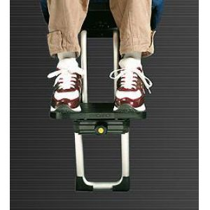
Seat-integrated Footrest

Slide 6
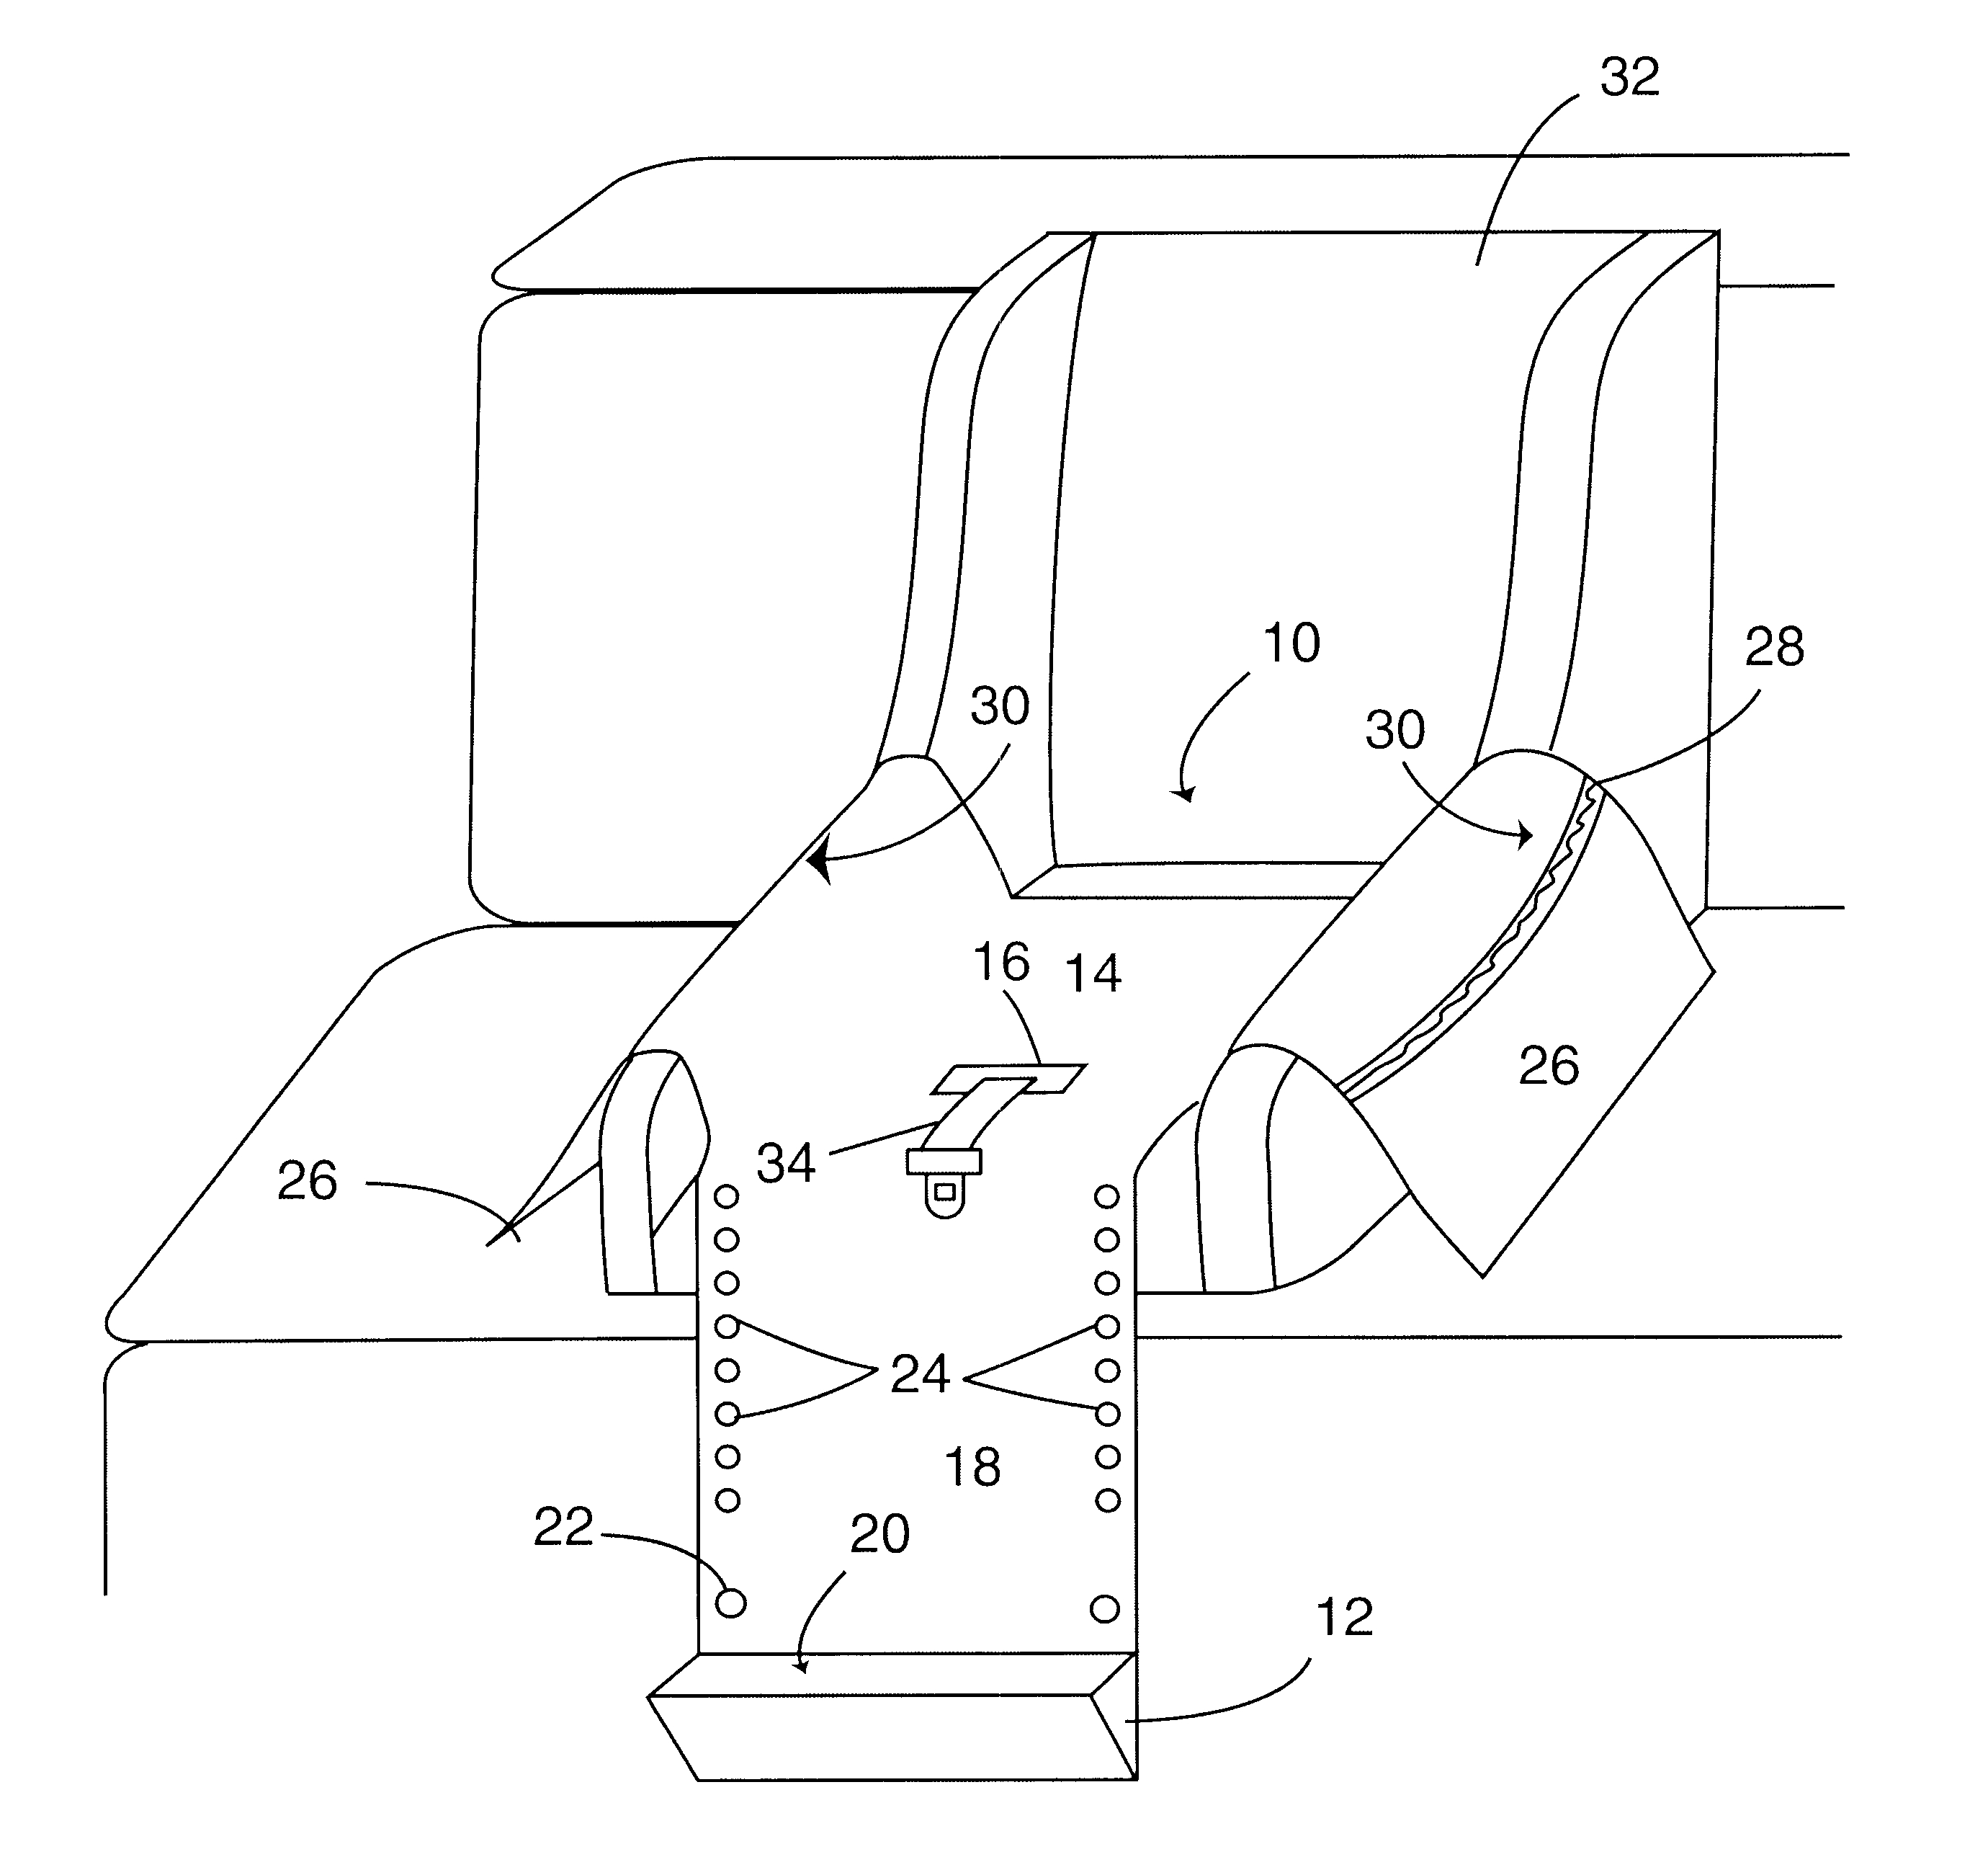
Patent #6561588

